Slide 1

Exploring Polarization and Homophily in Online and Offline Environments
James Flamino

Slide 2



Introduction
Every person is unique, but there is fundamental behavior that can make their decision-making more predictable
One integral behavior is value homophily
  Definition: behavior where people are more likely to interact with, and connect to, people with similar attributes
  These attributes include cultural, physical, behavioral, and material traits
Accounting for the drive of homophily can help researchers predict multiple different behavioral patterns, such as why some students will form in-groups on campus, or why users will migrate to or from different social media platforms or create isolated groups within the platform

Slide 3


Offline social groups
Time
The introduction of social media has enhanced and complemented offline interactions, not replaced it
However, it is harder to analyze offline interactions (paucity of traceable data), making the analysis of offline social groups the perfect target for novel research
Most offline group interactions occur within small face-to-face groups, not isolated dyads
These groups are not static, they evolve over time as members join or leave

Slide 4


The NetSense study
Follows 196 randomly selected incoming freshman at the University of Notre Dame
Follows these students from Fall 2011 to Spring 2013
Collects Bluetooth proximity records of the participants, and includes demographic surveys that the students submit once every semester (so four in total)
The Bluetooth data tracks when a participant is near another phone (participant or otherwise) allowing for us to track consistent encounters and map out real-life offline social groups
The demographic surveys let us identify participant opinions on topics such as politics, abortion, marijuana usage, etc
NetSense

Slide 5



Group detection
We follow the methodology implemented in [1]:
  For each semester, take snapshots of the Bluetooth network at 10-minute intervals
  Find the connected components within these snapshots
  Merge components within snapshots to find consistently occurring groups
The merge steps involves hierarchical clustering, joining together groups within and across snapshots as determined by a set of thresholds
Group
Component 1
Component 2
[1] A. Bahulkar, B. K. Szymanski, K. Chan, and O. Lizardo “Impact of attributes on group formation” in 2018 IEEE/ACM Inter. Conf. Adv. Soc. Netw. Anal. Min. IEEE, Oct. 2018, pp. 1250-1257
Notes:
The Bluetooth network is formed by drawing dyadic links between all nodes (NetSense participants and non-participants that were successfully detected) that are within close enough proximity as determined by the Bluetooth data.

Slide 6
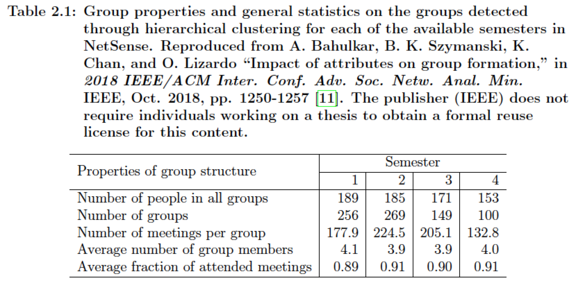
Group detection
Group properties and general statistic on the groups detected through hierarchical clustering for each of the available semesters in NetSense. Reproduced from [1].
[1] A. Bahulkar, B. K. Szymanski, K. Chan, and O. Lizardo “Impact of attributes on group formation” in 2018 IEEE/ACM Inter. Conf. Adv. Soc. Netw. Anal. Min. IEEE, Oct. 2018, pp. 1250-1257

Slide 7
Group detection
Time
We identify groups that persist between semesters by finding the group matchings that have the greatest member overlap
The difference in members between previous semester groups and the next semester groups identifies which individuals left or joined the next semester groups
With this mapping and the demographic surveys from NetSense, we can investigate opinion alignments of the members in groups and how that affects subsequent membership changes using empirical validation
Semester 1
Semester 2
Semester 3

Slide 8
Sociological processes in group dynamics
This is where value homophily becomes useful for our research
Recall that value homophily dictates that individuals will be attracted to, or interact with, others that share common attributes
In [2], the authors found that five common topics in the NetSense surveys were found to be the most predictive of the formation of new social relationships:
  General political orientation
  Abortion
  Marijuana usage
  Gay marriage rights
  Alcohol drinking habits
[2] A. Bahulkar, B. K. Szymanski, N. Chawla, O. Lizardo, and K. Chan, “Influence of personal preferences on link dynamics in social networks,” J. Complex., vol. 2017, Sep. 2017.

Slide 9
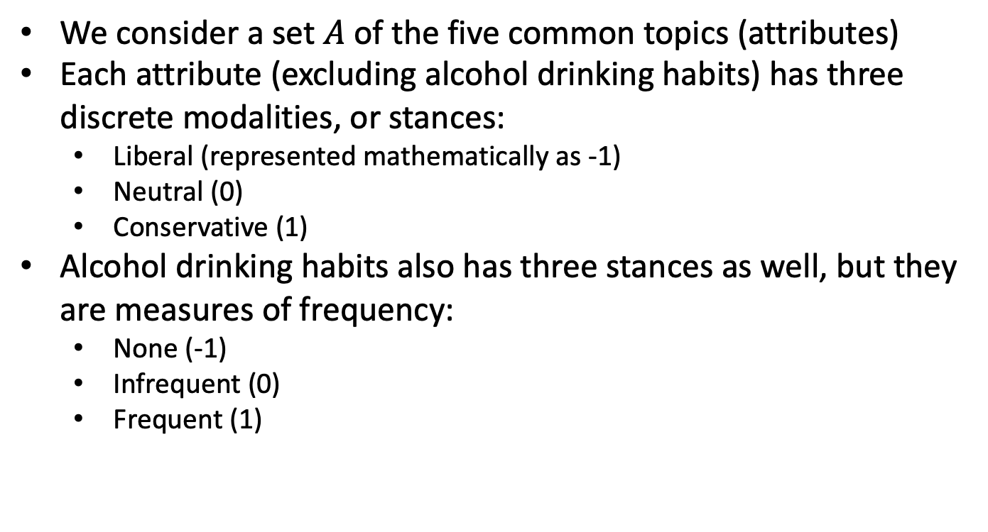
NetSense attributes
We consider a set $A$of the five common topics (attributes)
Each attribute (excluding alcohol drinking habits) has three discrete modalities, or stances:
  Liberal (represented mathematically as -1)
  Neutral (0)
  Conservative (1)
Alcohol drinking habits also has three stances as well, but they are measures of frequency:
  None (-1)
  Infrequent (0)
  Frequent (1)

Slide 10
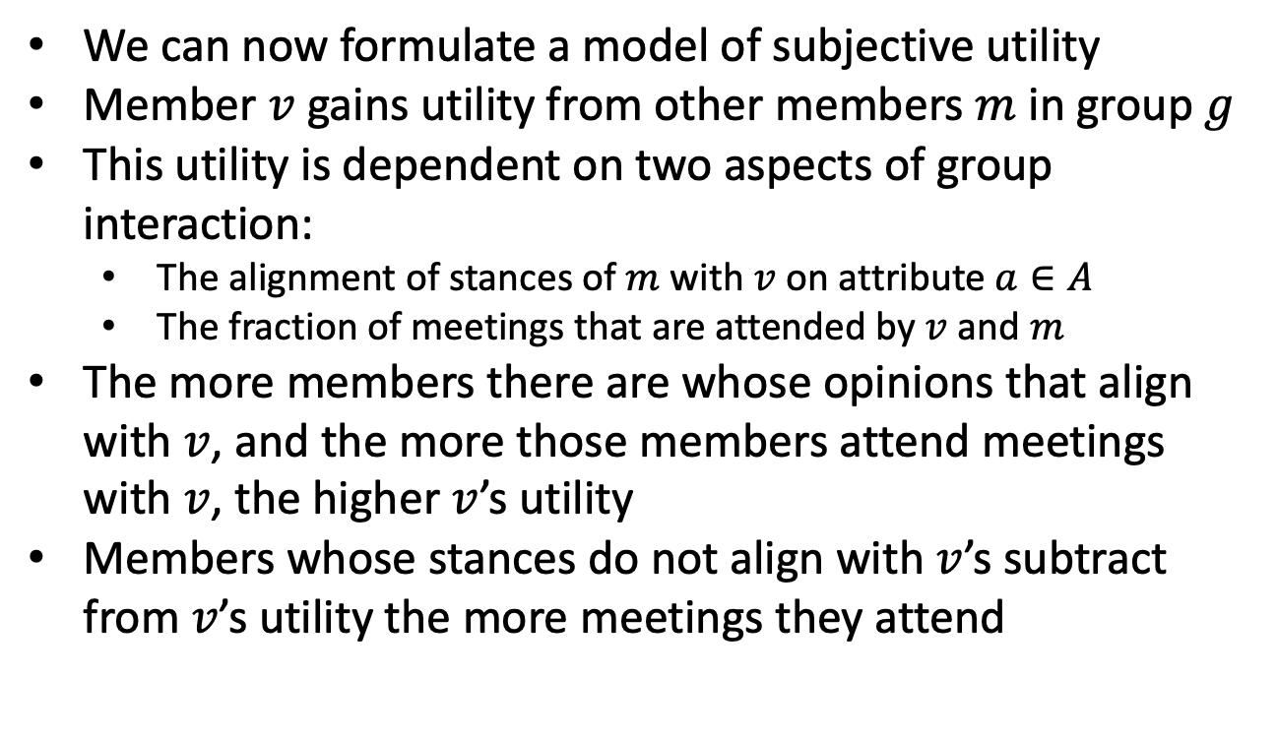
Utility of group member interactions
We can now formulate a model of subjective utility
Member $v$ gains utility from other members $m$ in group $g$
This utility is dependent on two aspects of group interaction:
  The alignment of stances of $m$ with $v$ on attribute $a∈A$
  The fraction of meetings that are attended by $v$ and $m$
The more members there are whose opinions that align with $v$, and the more those members attend meetings with $v$, the higher $v$’s utility
Members whose stances do not align with $v$’s subtract from $v$’s utility the more meetings they attend
Low Utility
High Utility
High Utility
Low Utility
Notes:
Utility is a representation of benefit.

Slide 11
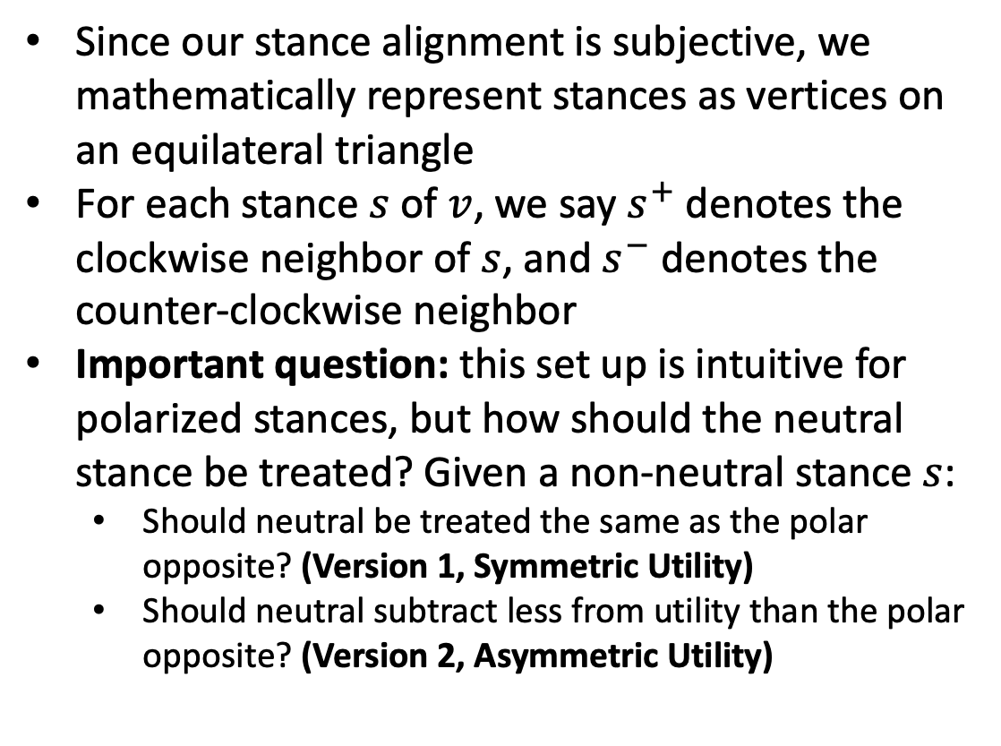



Utility of group member interactions
Since our stance alignment is subjective, we mathematically represent stances as vertices on an equilateral triangle
For each stance $s$ of $v$, we say $s^{+}$ denotes the clockwise neighbor of $s$, and $s^{−}$ denotes the counter-clockwise neighbor
Important question: this set up is intuitive for polarized stances, but how should the neutral stance be treated? Given a non-neutral stance $s$:
  Should neutral be treated the same as the polar opposite? (Version 1, Symmetric Utility)
  Should neutral subtract less from utility than the polar opposite? (Version 2, Asymmetric Utility)
Neutral ($0$)
Liberal ($−1=0^{−}=1^{+}$)
Conservative ($1$)

Slide 12
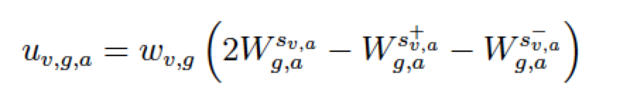
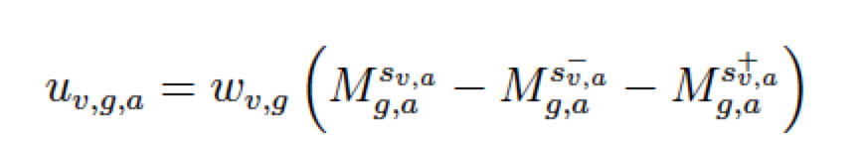
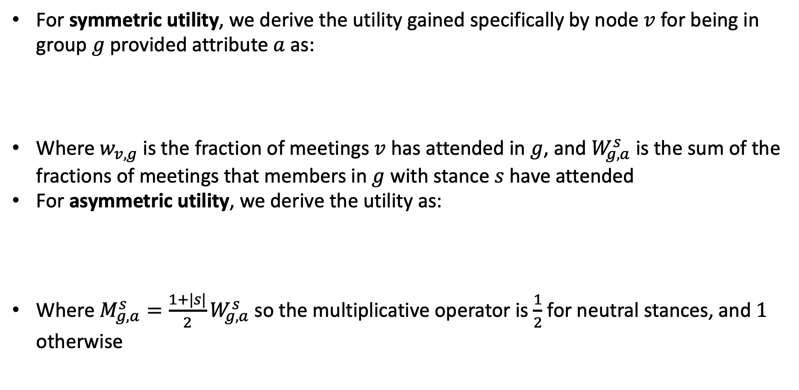
Personal utility equations
For symmetric utility, we derive the utility gained specifically by node $v$ for being in group $g$ provided attribute $a$ as:
Where $w_{v,g}$ is the fraction of meetings $v$ has attended in $g$, and $W_{g,a}^{s}$ is the sum of the fractions of meetings that members in $g$ with stance $s$ have attended
For asymmetric utility, we derive the utility as:
Where $M_{g,a}^{s}=\frac{1+|s|}{2}W_{g,a}^{s}$ so the multiplicative operator is $\frac{1}{2}$ for neutral stances, and $1$ otherwise
Notes:
For version 1 (alpha), this means a person gains twice as much utility from being with fellow members who have the same opinion than utility lost from being with members who have mis-aligned opinions
For version 2 (beta), this means a person whose opinion is liberal or conservative loses only half as much utility from being with other members whose opinions are neutral. People with neutral opinions, however, lose the same amount of utility by being with other members whose opinions are liberal and conservative as the utility they gain from being with other neutral members.

Slide 13
Maximizing utility criterion
We hypothesize that the group membership changes (and stance changes) are driven by a person’s attempt to maximize value homophily (i.e., utility)
We categorize this mechanism into three criterion:
  Egocentric: Maximizing only the target individual’s utility
  Weakly altruistic: Maximizing the utility of like-minded peers
  Strongly altruistic: Maximizing the utility of all effected members
Scenario 1
Egocentric: ✓
Weakly Altruistic: ✓
Strongly Altruistic: ✓
Scenario 2
Egocentric: ✓
Weakly Altruistic: ✓
Strongly Altruistic: X
Scenario 3
Egocentric: ✓
Weakly Altruistic: X
Strongly Altruistic: X
Notes:
The criterion are mutually inclusive

Slide 14
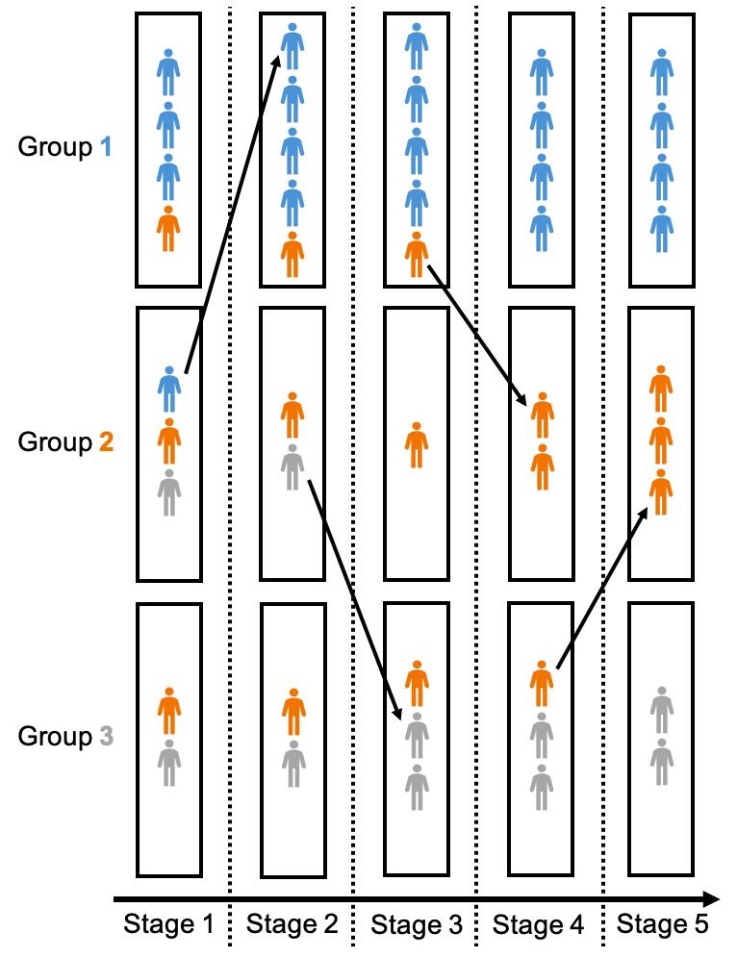
Polarization: a result of homophily
Polarization is defined as the segregation of a group of individuals into distinct opposing tendencies, divided by some attribute on a spectrum (such as political stance)
When people let the drive of value homophily dictate group membership, polarization invariable rises
This effect is commonly seen online
  Example: pre-Musk Twitter was more left-leaning and anti-fake news, driving off more extreme users, prompting the formation of Parler, causing greater levels of polarization on both platforms
Notes:
The criterion are mutually inclusive

Slide 15
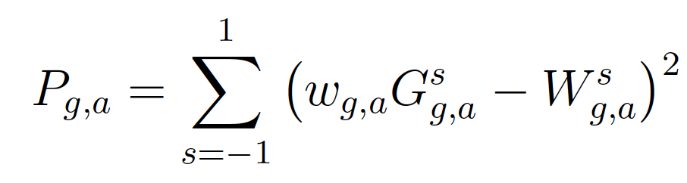
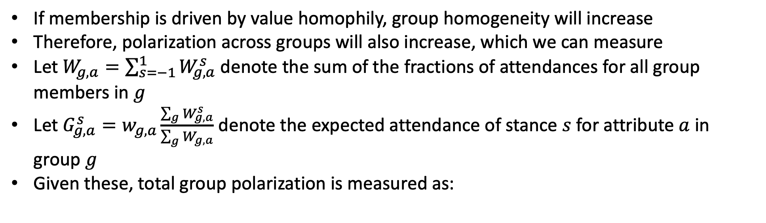
Measuring polarization
If membership is driven by value homophily, group homogeneity will increase
Therefore, polarization across groups will also increase, which we can measure
Let $W_{g,a}=\sum_{s=−1}^{1}{W_{g,a}^{s}}$ denote the sum of the fractions of attendances for all group members in $g$
Let $G_{g,a}^{s}=w_{g,a}\frac{\sum_{g}{W_{g,a}^{s}}}{\sum_{g}{W_{g,a}}}$ denote the expected attendance of stance $s$ for attribute $a$ in group $g$
Given these, total group polarization is measured as:
Notes:
The total group polarization is just the sum of the values of this function for each attribute. Polarization is 0 when there is a full agreement between the global and local frequencies of stances among members (so fully heterogenous distribution of opinions in and across groups). It grows when members increasingly align their stances with each other. This can be accomplished within each group by members either changing their stances or leaving groups in which their stance is the minority, and joining those where their stance is the majority.

Slide 16
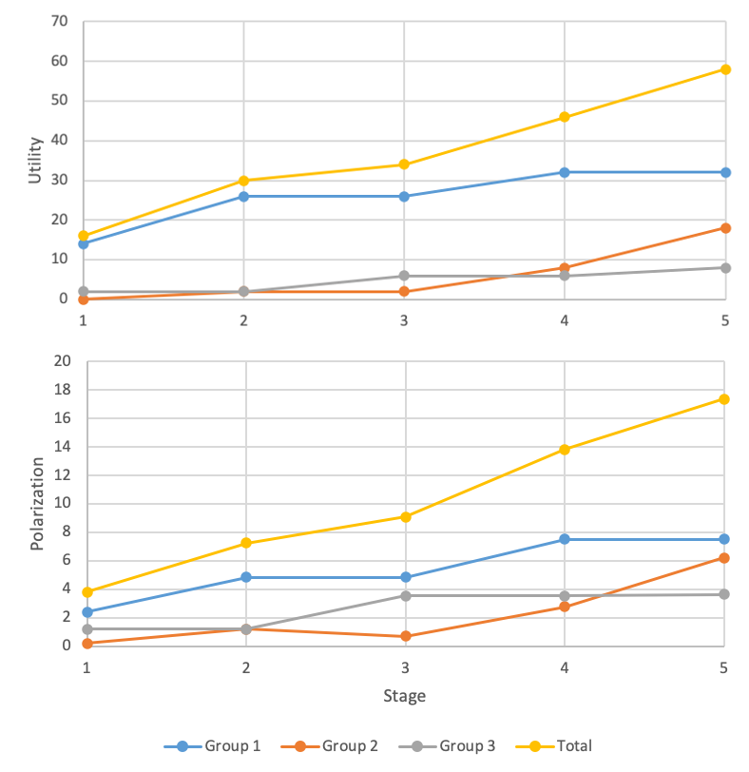
Example of utility and polarization growth

Slide 17
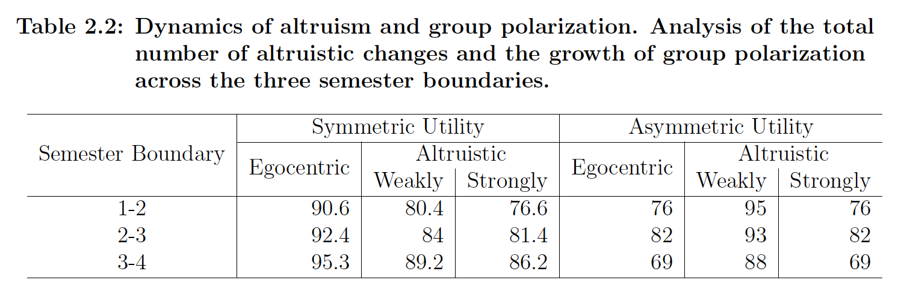
Validating utility and polarization
To validate our formulations of utility and polarization, we measure in percentage how many membership changes made in the actual data meet our criterion and increase polarization
Note: for the remainder of this chapter, we will be using symmetric utility, as it yields stronger results in NetSense
Notes:
In asymmetric utility, you could explain egocentric being lower than weakly altruistic as a potential exhibition of “peer pressure”, where users are more likely to make changes to satisfy societal and peer-based expectations as opposed to their own, especially for those that are their “friends”, or people that are aligned with them.

Slide 18
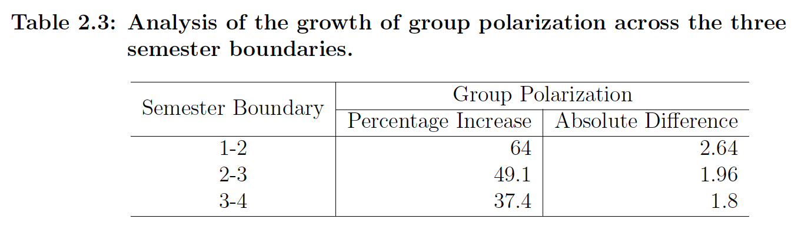
Validating utility and polarization
Notes:
Note that while the magnitude of polarization increases lessens over time, polarization continues to increase between each semester boundary

Slide 19
Utility of majority and minority opinions
Having validated utility, we can answer the questions: does having a majority/minority opinion affect utility gain? Does having a majority/minority opinion affect membership retention?
For the latter question: majority stance holders retain membership in 85% of groups while minority stance holders retain membership in 75%
For the former question: For each topic we find the ratio of average utility gained by members with the minority stance over average utility gained by members with majority stance
  Gay marriage: 0.55
  Political orientation: 0.29
  Legalization of marijuana: 0.25
  Abortion: 0.11

Slide 20
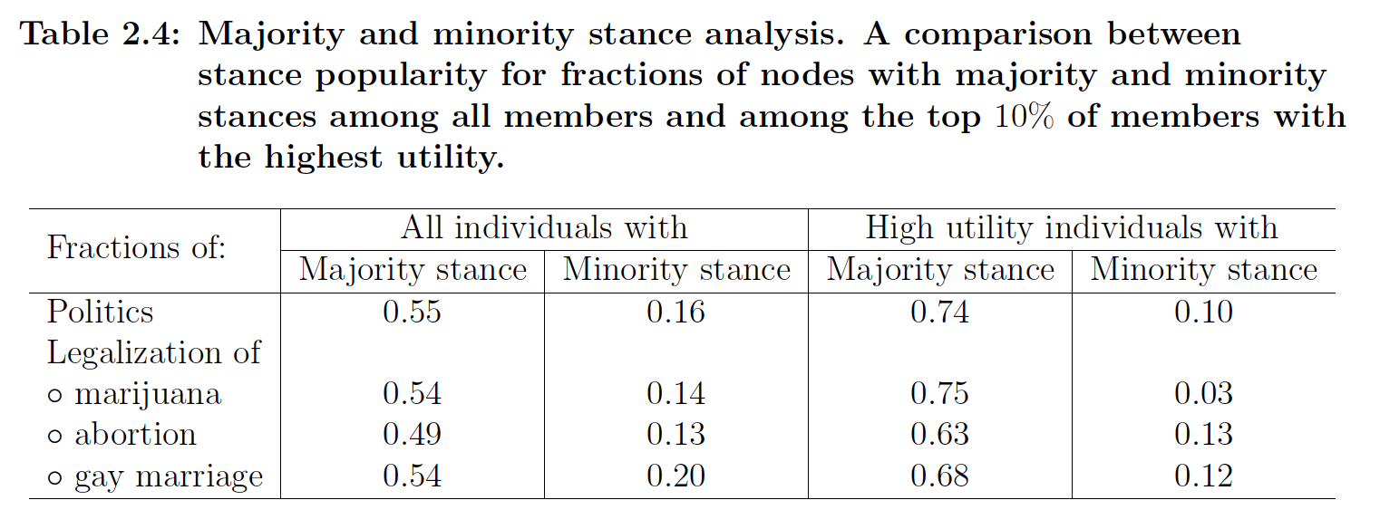
Utility of majority and minority opinions
We also find the fractions of people with majority and minority stances over the entire population, and for the top 10% of particpants, ordered by the utility they received
Notes:
We exclude alcohol drinking frequency from this analysis as it is a measure of frequency, not a stance along a polarized scale (where majorities and minorities are more important)

Slide 21
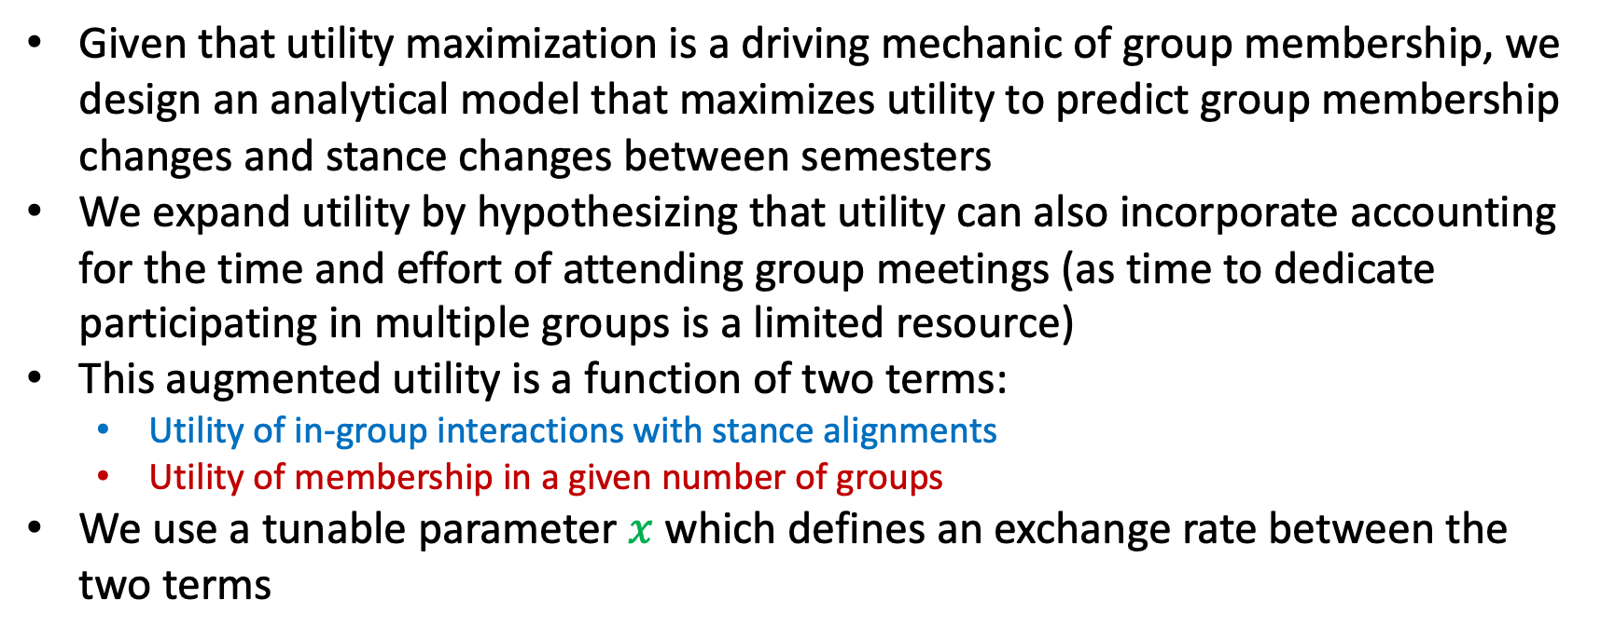
Analytical model for predictions
Given that utility maximization is a driving mechanic of group membership, we design an analytical model that maximizes utility to predict group membership changes and stance changes between semesters
We expand utility by hypothesizing that utility can also incorporate accounting for the time and effort of attending group meetings (as time to dedicate participating in multiple groups is a limited resource)
This augmented utility is a function of two terms:
  Utility of in-group interactions with stance alignments
  Utility of membership in a given number of groups
We use a tunable parameter $x$ which defines an exchange rate between the two terms

Slide 22
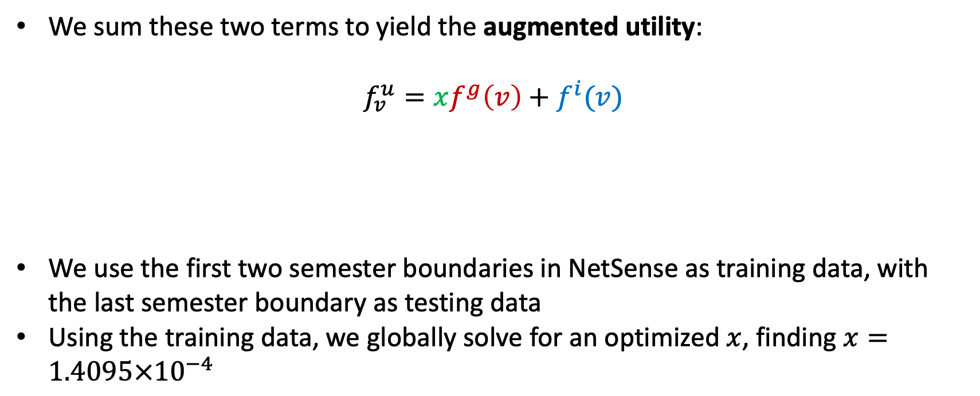
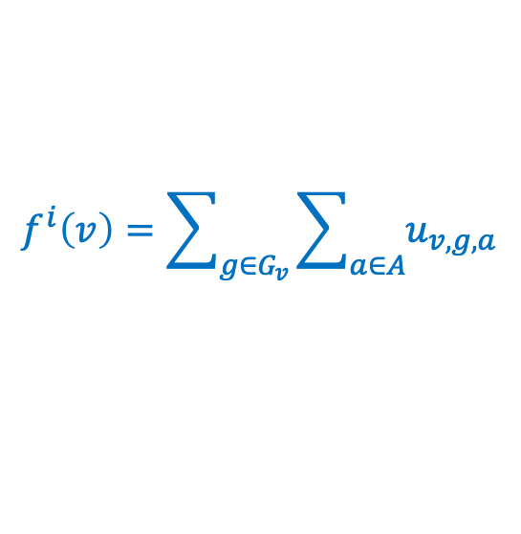

Augmented utility
We sum these two terms to yield the augmented utility:
$$f_{v}^{u}=xf^{g}\left(v\right)+f^{i}(v)$$
We use the first two semester boundaries in NetSense as training data, with the last semester boundary as testing data
Using the training data, we globally solve for an optimized $x$, finding $x=1.4095×{10}^{−4}$
$$f^{g}\left(v\right)=W_{v}(2\overline{W}−W_{v})$$
$$f^{i}\left(v\right)=\sum_{g∈G_{v}}{\sum_{a∈A}{u_{v,g,a}}}$$

Slide 23
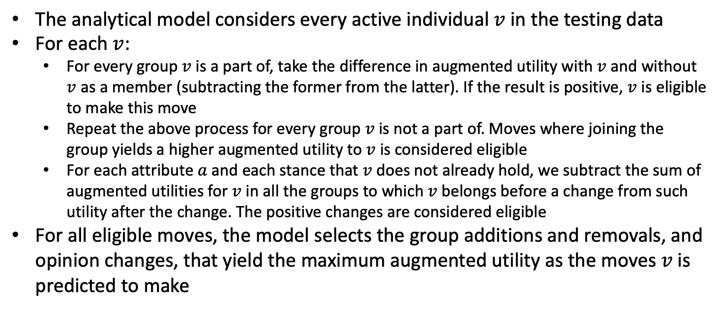
Analytical model for predictions
The analytical model considers every active individual $v$ in the testing data
For each $v$:
  For every group $v$ is a part of, take the difference in augmented utility with $v$ and without $v$ as a member (subtracting the former from the latter). If the result is positive, $v$ is eligible to make this move
  Repeat the above process for every group $v$ is not a part of. Moves where joining the group yields a higher augmented utility to $v$ is considered eligible
  For each attribute $a$ and each stance that $v$ does not already hold, we subtract the sum of augmented utilities for $v$ in all the groups to which $v$ belongs before a change from such utility after the change. The positive changes are considered eligible
For all eligible moves, the model selects the group additions and removals, and opinion changes, that yield the maximum augmented utility as the moves $v$ is predicted to make

Slide 24
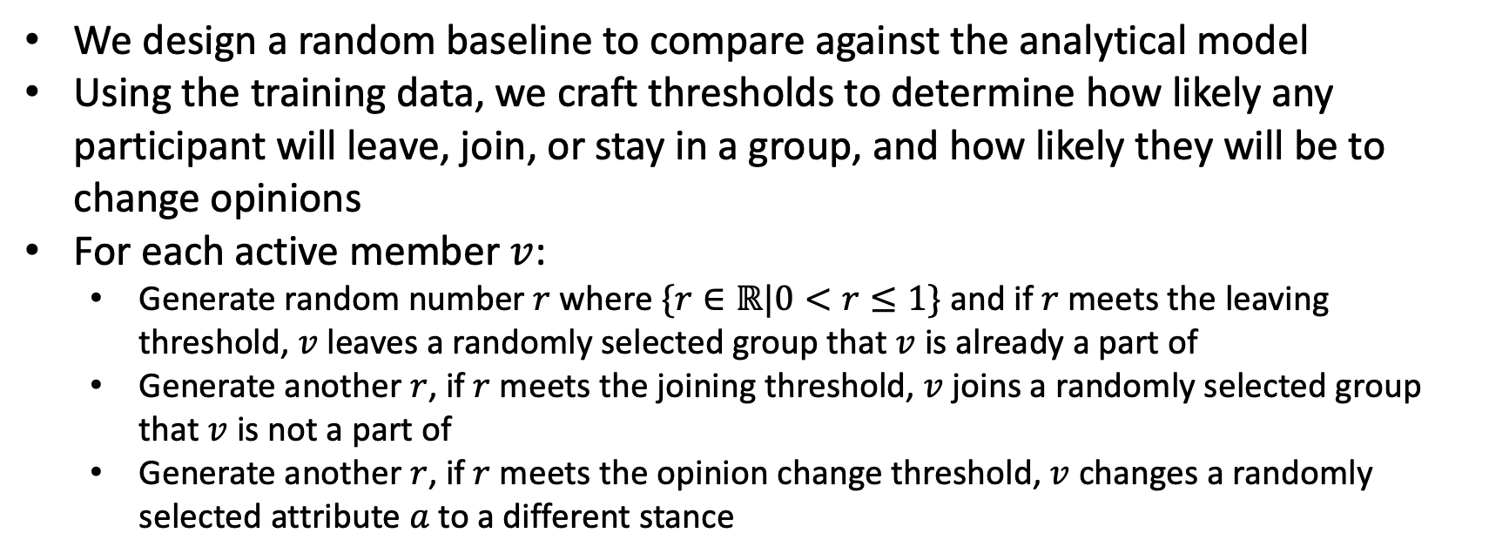
Random baseline
We design a random baseline to compare against the analytical model
Using the training data, we craft thresholds to determine how likely any participant will leave, join, or stay in a group, and how likely they will be to change opinions
For each active member $v$:
  Generate random number $r$ where $\{r∈ℝ|0<r≤1\}$ and if $r$ meets the leaving threshold, $v$ leaves a randomly selected group that $v$ is already a part of
  Generate another $r$, if $r$ meets the joining threshold, $v$ joins a randomly selected group that $v$ is not a part of
  Generate another $r$, if $r$ meets the opinion change threshold, $v$ changes a randomly selected attribute $a$ to a different stance

Slide 25
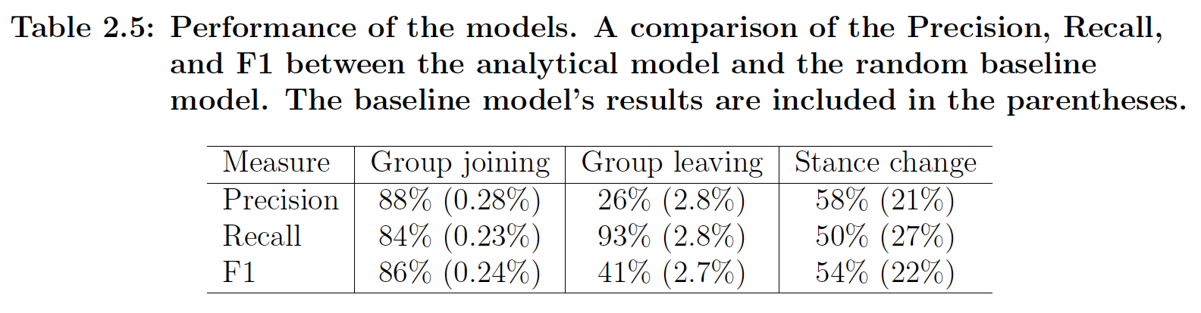
Model results and comparisons
Running both models on the testing data, we get the results:
Notes:
Recall attempts to answer the following question: What proportion of actual positives was identified correctly?
Precision attempts to answer the following question: What proportion of positive identifications was actually correct?
F1 is a measure that balances the two.
These are essentially measures of prediction quality, where the higher the percentage, the better the model is at correctly predicting changes.

Slide 26
Conclusions of offline social group analysis
Utility derived from the alignment of similar stances on important topics is a driving mechanic that can determine group membership and opinion changes in empirical data
While almost all membership changes benefit the one making the change, often the changes benefit members with the same opinions, and sometimes even all members
Almost all moves driven by this mechanic result in increasing polarization, growing opinion homogeneity in groups
People holding majority opinions enjoy higher membership retention, and overall utility gains
Read more at: Flamino, James, et al. "Creation, evolution, and dissolution of social groups." Scientific Reports 11.1 (2021): 17470.

Slide 27
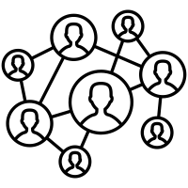
Online social groups
The driving force of value homophily can be more easily seen in online behavior
The mask of an online profile often reduces decorum in user behavior, cultivating more extreme interactions and views that produce greater displays of value homophily
This, in combination with curated content from social media algorithms, creates massive levels of polarization in online social groups
Greatly polarized social groups create “echo chambers”
  Echo chambers are where users that reside within that social group hear and discuss narratives that only align with their own beliefs with no external input

Slide 28
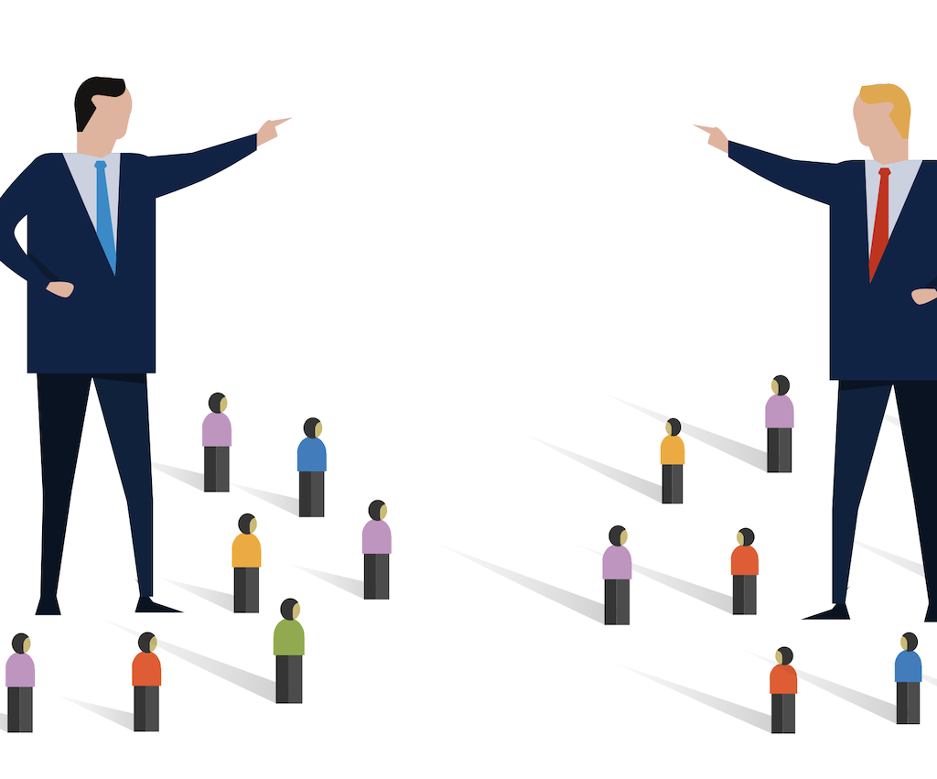

Exploring polarization further
Earlier, we defined polarization as the segregation of a group of individuals into distinct opposing tendencies, divided by some attribute on a spectrum
However, there is much more to this
Polarization is commonly used when discussing politics, especially within the topic of social media
Political scientists break polarization into four types, each with three levels of affect
Notes:
Policy polarization: extreme differences of opinion on highly salient issues
Partisan polarization: alignment of opinions with opposing political parties
Ideological polarization: alignment of opinions with liberal vs. conservative world views
Geographic polarization: regional alignment of opinions. For example, “red state/blue state”

Slide 29
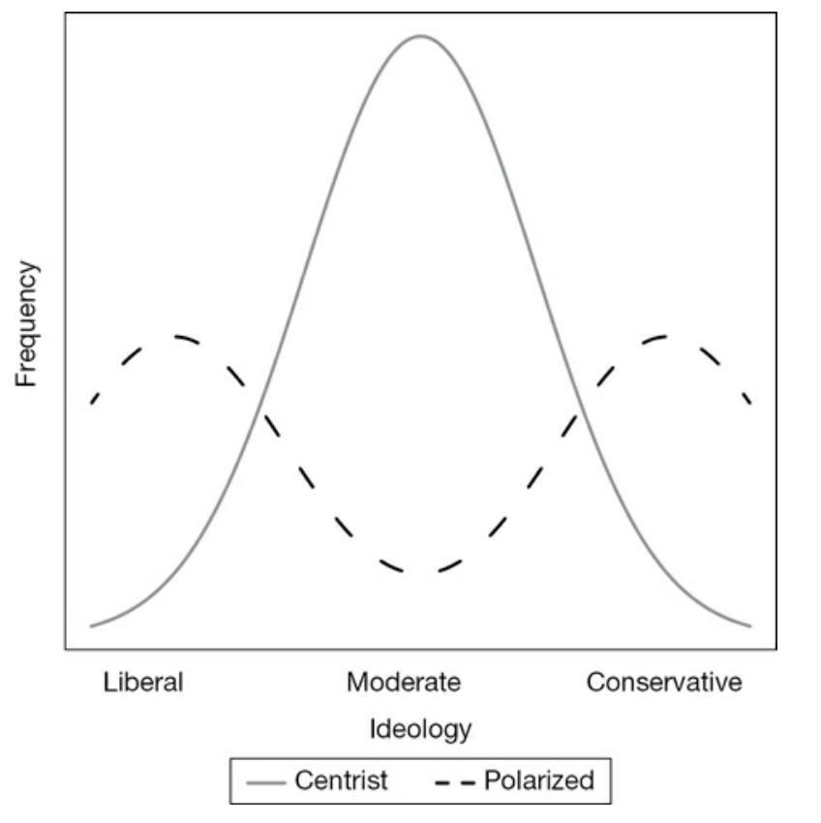
Exploring polarization further
Political scientists break polarization into four types, each with three levels of affect
The four types of polarization:
  Policy polarization
  Partisan polarization
  Ideological polarization
  Geographic polarization
The four levels of affect of polarization:
  Elite polarization
  Media polarization
  Voter polarization
Figure ref: McCarty, Nolan. Polarization: What everyone needs to know®. Oxford University Press, 2019.
Notes:
Policy polarization: extreme differences of opinion on highly salient issues
Partisan polarization: alignment of opinions with opposing political parties
Ideological polarization: alignment of opinions with liberal vs. conservative world views
Geographic polarization: regional alignment of opinions. For example, “red state/blue state”
--------------------------
Elite polarization: polarization amongst political officials and pundits
Media polarization: polarization amongst media and news organization
Voter polarization: polarization amongst the common voter (as usually measured by respondents in opinion surveys)

Slide 30
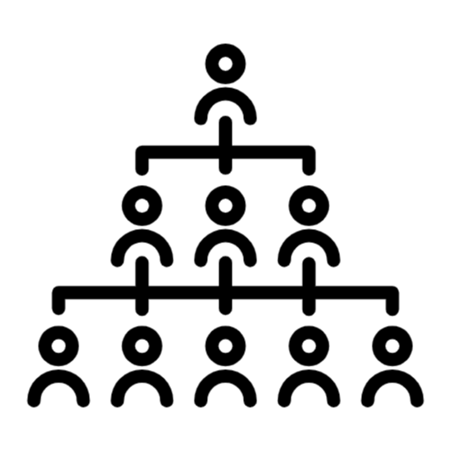
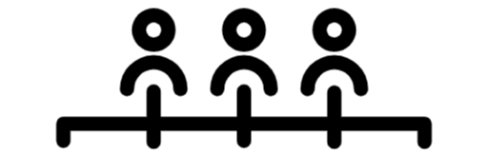

Exploring polarization further
Traditionally, the degrees and direction of influence and interaction between these levels of affect were more strictly hierarchical
Social media has lowered the barrier of interaction so influence can more easily be attained at all levels
This widens the range of entities that can politically influence general audiences
This has been established, but how do top political influencers change over time?
Importantly, does this facilitate an increase in polarization?
Common Voters
Political Elites
News Organizations
Political Elites
Common Voters
News Organizations

Slide 31

Analyzing polarization in online social groups
As mentioned earlier, social media has essentially “super-charged” political homophily behavior, causing greatly increasing levels of polarization
Therefore, a longitudinal study is needed to explore how polarization within Twitter has evolved and how those catalyzing information spread have evolved with it

Slide 32

The data
We collected Twitter data on the 2016 and 2020 U.S. presidential elections
For 2016 we collected data from June 1st to November 8th and for 2020 we collected from June 1st to November 2nd
171 million tweets were generated by 11 million users in 2016, and 702 million tweets were generated by 20 million users in 2020

Slide 33
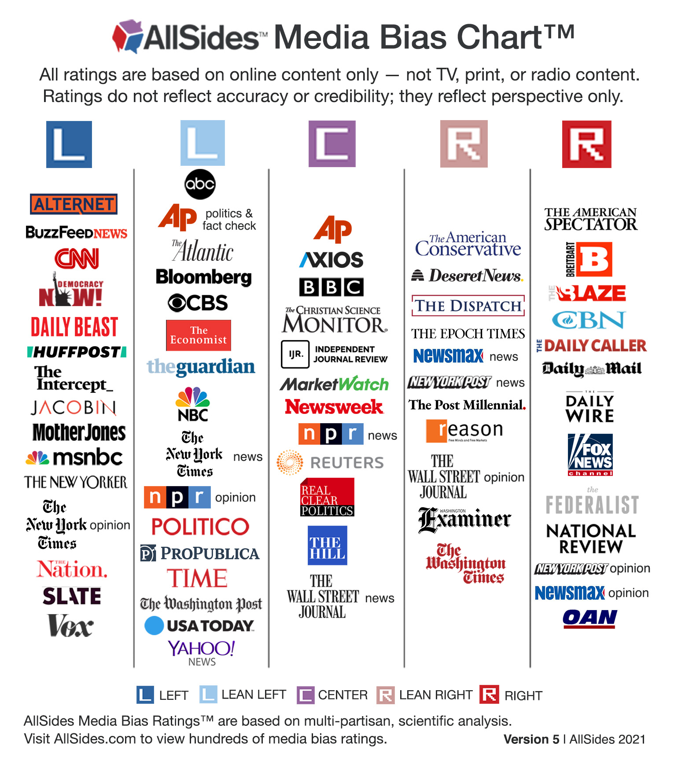
Identifying news
We extracted the domain names of each Tweet containing a URL and classified all news media outlet (e.g. cnn.com) links
We grouped news outlet links into 8 categories of political alignment based on the linked news media outlet’s biases:
Fake news
Extreme bias right
Right
Lean right
Center
Lean left
Left
Extreme bias left
Classifications were derived from allsides.com and mediabiasfactcheck.com
Figure ref: https://www.allsides.com/media-bias/media-bias-chart

Slide 34
URL links
Notes:
Figure description: Distribution of news media links in 2016 and 2020, by news media category. Panels A and B the proportion of tweets and users having sent tweets with a URL pointing to a website belonging to one of the categories. Users are classiﬁed in the category in which they posted the most links. For the users that have at least two links classified, panels C and D report the fraction of links across categories as a function of the users’ main categories.

Slide 35
Identifying influencers
We assembled a retweet network for each news media bias classification, for 2016 and 2020 separately
The higher a node's out-degree, the greater this user’s local influence
But local network properties (e.g. out-degree centrality) are ineffective for identifying influencers
The Collective Influence (CI) algorithm considers influence as an emergent collective property by finding the smallest set of nodes needed for global cascades
CI can identify critical “super-spreaders” of information in social networks, and rank their overall influence
Node v (influencer)
… has content retweeted by
Node u (author)
Notes:
A node in the retweet network is represented by a user
An edge between nodes represents the retweeting of some content that contains a categorized URL
Local properties will incorrectly identify users that went viral once, or just happen to produce a lot of content
Influencers are identified and ranked in each network using CI

Slide 36
POI in 2016 influencers
Center News
@CNN
@thehill
@politico
@CNNPolitics
@DRUGE_REPORT
Left News
@HuffPost
@TIME
@thedailybeast
@RawStory
@HuffPostPol
Fake News
@PrisonPlanet
@RealAlexJones
@zerohedge
@DRUDGE_REPORT
@realDonaldTrump
Right News
@FoxNews
@realDonaldTrump
@dcexaminer
@DRUDGE_REPORT
@PrisonPlanet
Left Leaning News
@nytimes
@washingtonpost
@ABC
@NBCNews
@ HillaryClinton
Extreme Bias Left News
@Bipartisanism
@PalmerReport
@peterdaou
@crooksandliars
@BoldBlueWave
Right Leaning News
@WSJ
@WashTimes
@RT_com
@realDonaldTrump
@RT_America
Extreme Bias Right News
@realDonaldTrump
@DailyCaller
@BreitbartNews
@wikileaks
@DRUDGE_REPORT
Notes:
RT_America and RT_com are Russian-affiliated entities

Slide 37
POI in 2020 influencers
Center News
@thehill
@AP
@Reuters
@kylegriffin1
@JonLemire
Left News
@MSNBC
@thedailybeast
@kylegriffin1
@DavidCornDC
@JoeBiden
Fake News
@seanhannity
@OANN
@zerohedge
@PrisonPlanet
@realDonaldTrump
Right News
@DonaldJTrumpJr
@marklevinshow
@jsolomonReports
@FoxNews
@realDonaldTrump
Left Leaning News
@CNN
@nytimes
@kylegriffin1
@ABC
@ NBCNews
Extreme Bias Left News
@DearAuntCrabby
@funder
@ImpeachmentHour
@MeidasTouch
@TheDemCoalition
Right Leaning News
@nypost
@WSJ
@DonaldJTrumpJr
@EricTrump
@realDonaldTrump
Extreme Bias Right News
@DonaldJTrumpJr
@BreitbartNews
@dbongino
@marklevinshow
@realDonaldTrump

Slide 38
Measuring polarization
Influencers represent politically biased modalities
We used them to measure if there are any changes in ideological polarization
Polarization increases as users segregate themselves while propagating information from influencers
Example: users will either retweet influencers from the left or the right, with little overlapping retweeting in between
Figure ref: McCarty, Nolan. Polarization: What everyone needs to know®. Oxford University Press, 2019.

Slide 39



Measuring polarization
Influencer v
For each year, we gathered the top 100 influencers across each news category and removed all news category labels, creating two sets
For each set we generated an undirected, complete graph where a node is an influencer, and the edges are weighted by how similar the linked nodes are in the users that retweet their content
We ran community detection on the two networks to see how influencers are grouped by the users that retweet them
… is retweeted by
v’s retweeters
Edge weight =
$$cos sim{θ}$$
u’s retweeters
… is retweeted by
Influencer u
Notes:
NOTE: We also ensure that both sets only include influencers that show up in both 2016 and 2020
Example of edge similarity:
If every user that has retweeted influencer v’s content has also retweeted influencer u’s content, then the edge weight between v and u is 1
If none of the same users have retweeted v’s and u’s content, then the weight is 0

Slide 40
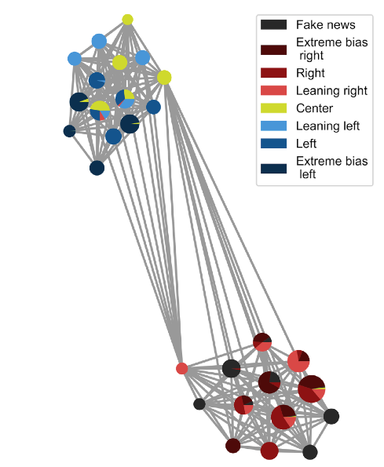
Measuring polarization
Two communities were found, and the news category labels were re-assigned
One community had left-biased influencers and one had right-biased influencers (see figure for sub-sampled example)
We quantified community cohesion and separation using modularity and normalized cut
Modularity results:
  0.365 (SE = 0.007) in 2016
  0.39 (SE = 0.01) in 2020
Normalized cut results:
  0.36 (SE = 0.04) in 2016
  0.128 (SE = 0.005) in 2020
Notes:
Figure is a small sub-sample of the 2020 network. Figure caption: Similarity network for a random subsample of the 2020 influencers. Each edge is weighted by the cosine similarity between retweeting users. Size of the node represents that node's degree centrality. The pie charts representing the nodes illustrate the news categories to which that node belongs, with the size of the slices denoting their relative influence for that category. For clarity, edges below the average inter-community edge weight are hidden. Nodes are grouped relative to each other by their detected community.
Modularity is the fraction of the edges that fall within the given groups minus the expected fraction if edges were distributed at random. The value of the modularity for unweighted and undirected graphs lies in the range [-0.5,1]. It is positive if the number of edges within groups exceeds the number expected on the basis of chance. Networks with high modularity have dense connections between the nodes within modules but sparse connections between nodes in different modules.
A cut is a partition of the nodes of a graph into two sets. The cut size is the sum of the weights of the edges “between” the two sets of nodes. The normalized cut size is the cut size times the sum of the reciprocal sizes of the volumes of the two sets. The range is [0,1] where the lower the value, the greater the separation between the communities (as the normalized sum of the weights of the edges between the two sets is closer to 0). Given that we only ever detect two communities in our networks this works well to directly measure the separation of these communities.

Slide 41
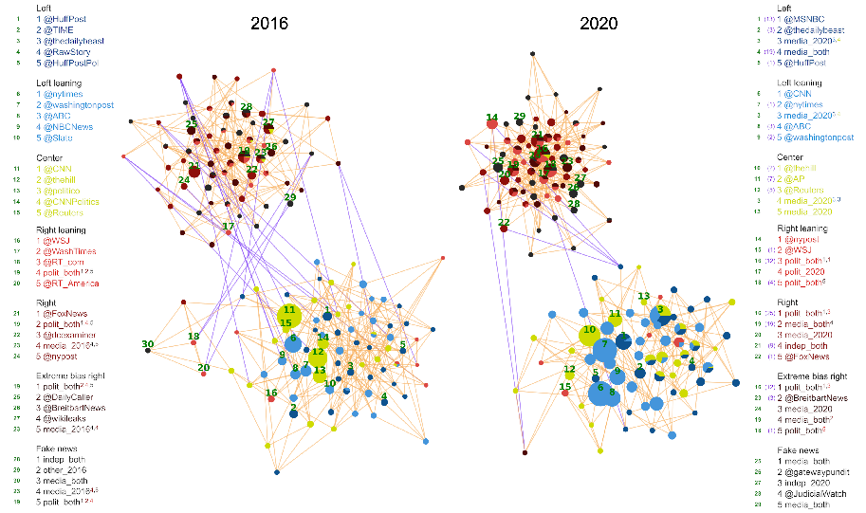
41
Notes:
Similarity networks for nodes in the union of the top 25 influencers from each news media category for the two election years.
Node size is proportional to its degree in their respective network. Node color indicates which news media category the node spreads. Nodes that spread information from more than one category are represented as pie charts, where the size of each slice is proportional to their CI score within that respective news media category. An edge between each pair of influencers is weighted by the similarity between the retweeters of those influencers. Both networks are visualized using a force-directed node layout, with the strength of the force defined by the weights of the edges. Since these are complete networks, they are sparsified for visualization purposes, where each node only has up to their five strongest edges visible. Each of the two networks has 405 visible edges in total. Visible inter-community edges are colored purple, while intra-community edges are orange. The distribution of the similarity values, and the degree distributions, for the visible edges of these two networks are shown in Supplementary Figure 5 b and d. Tables on either side of each of the two networks show the top five users of each news media category. A green number to the left of each user corresponds to a labeled node in the network showing the location of that top influencer. The purple numbers in the 2020 tables indicate the user’s 2016 rank in that category. Users ranked in the top 25 for multiple news media categories have colored superscripts, indicating the rank and media classification of their other top five positions.

Slide 42
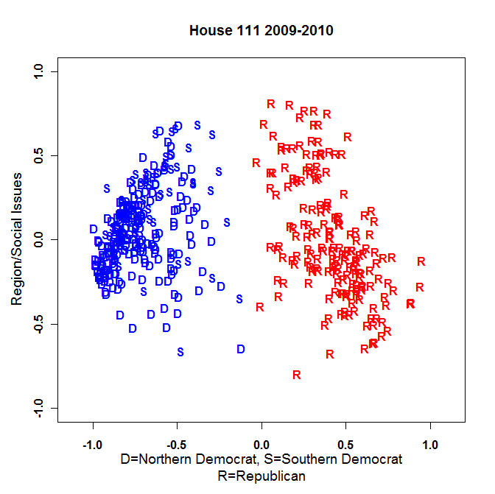
More measures of polarization
There are other ways to measure ideological polarization
From [4], we can infer the ideology of users from the ideological alignment of the political actors, journalists, and news media they follow
In [4] this produces ideological estimates of the members of the U.S. Congress that are highly correlated with ideological estimates such as DW-NOMINATE
We inferred this ideology for the influencers from the previous analysis and for all common users and distributed them across a histogram
[4] Barberá, Pablo. "Birds of the same feather tweet together: Bayesian ideal point estimation using Twitter data." Political analysis 23.1 (2015): 76-91.
Figure ref: https://en.wikipedia.org/wiki/NOMINATE_(scaling_method)
Notes:
Figure shows an example of W-NOMINATE, which is a variation of NOMINATE (which DW-NOMINATE is a variation of). NOMINATE (an acronym for Nominal Three-Step Estimation) is a multidimensional scaling application developed to analyze preferential and choice data, such as legislative roll-call voting behavior. Popularly applied to U.S. Congress and their House of Representatives.

Slide 43
Liberal
Conservative
Liberal
Conservative
2016
2020
Notes:
Note: Distribution of users and influencers by their ideological value assigned by decomposition. News category positions along this ideology scale are fake news = 1.333, extreme bias right = 1, right = 0.667, right leaning = 0.333, center = 0, left leaning = -0.333, left = -0.667, extreme bias left = -1.
Figure caption: Latent ideology scale of influencers and their retweeters in 2016 (left) and 2020 (right).
The latent ideology of the top five influencers of each category is shown as a box plot representing the distribution of the ideology of the users who retweeted them.
The distribution of the ideology estimate of the users is shown in green and the distribution of the ideology estimate of the top 100 influencers of each news media category (computed as the median of the ideology of their retweeters) is displayed in purple. Box plots indicate the 25% and 75% percentiles of the distributions with whiskers indicating the 5% and 95% percentiles. Pie charts next to the influencers' names represent the news categories to which they belong (weighted by their respective CI ranks in each category).

Slide 44
More measures of polarization
To quantify is polarization has increased between 2016 and 2020 using the ideological scale, we used Hartigan’s dip test
In our distribution, this indicates increasing separation from ideological consensus, resulting in polarization
User results:
  D = 0.11 in 2016
  D = 0.15 in 2020
Influencer results:
  D = 0.18 in 2016
  D = 0.21 in 2020
Notes:
Hartigan’s dip test measures unimodality. Increasing values of the test statistic D indicates distributions that increasingly deviate from unimodality

Slide 45
Conclusions of online social group analysis
70% of the collective top 100 influencers in 2020 were not present in 2016
The relative volume of extremist and fake news on Twitter has decreased
Despite this, multiple analyses confirm a robust pattern of increasing division into opposing Twitter echo chambers with growing in-group density and out-group separation
These analyses also confirm growing ideological separation of both users and influencers on Twitter
Hypothesis: Despite moderation of extremist and fake news, the influx of new, more polarized influencers (and the persistence of a few old, strongly polarized influencers) has helped enable the growth of polarization and the establishment of stronger political echo chambers
Read more at: Flamino, James, et al. "Political polarization of news media and influencers on Twitter in the 2016 and 2020 US presidential elections." Nature Human Behaviour (2023): 1-13.

